Slide 1
SAP-C01: Security, Identity & Compliance
Iam, waf, Shield, KMS, CLOUDHSM
AWS Certified Solutions Architect– Professional (SAP-C01)
Study notes - Sep’2019

Slide 2
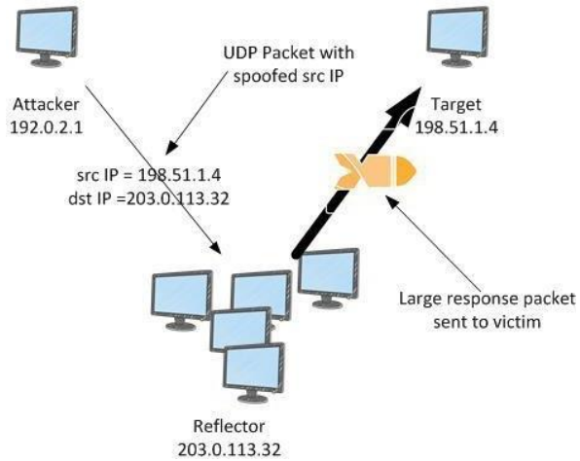
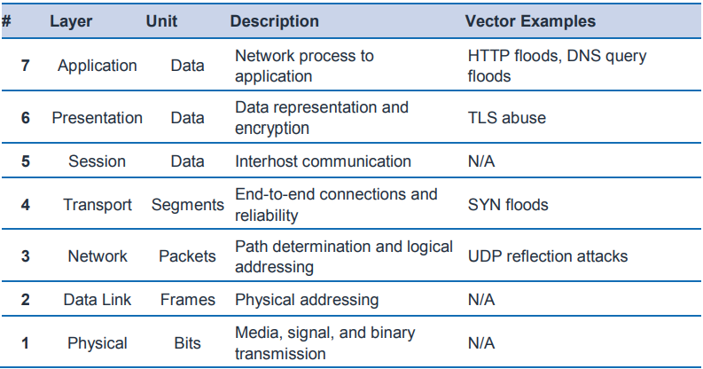
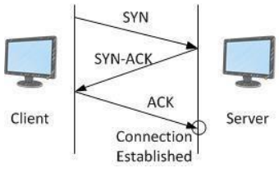
AWS Best Practices for DDoS Resiliency - Attacks
https://d1.awsstatic.com/whitepapers/Security/DDoS_White_Paper.pdf
UDP Reflection attack
(Src IP spoofing)
Application
attacks
Infrastructure
attacks
SYN Floods
(No Final ACK)
HTTP floods | High volume seemingly valid requests
Cache busting | Variations in query string to circumvent CDN caching
DNS | Uses many well formed DNS queries to exhaust DN server
TLS Abuse | Send intelligible data, force re-negotiating the encryption method, Open many TLS sessions

Slide 3
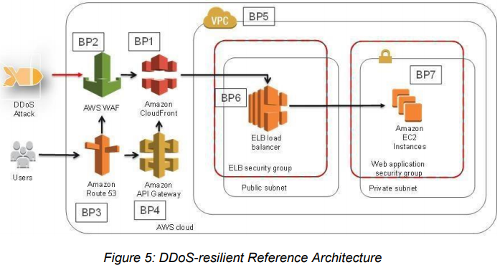
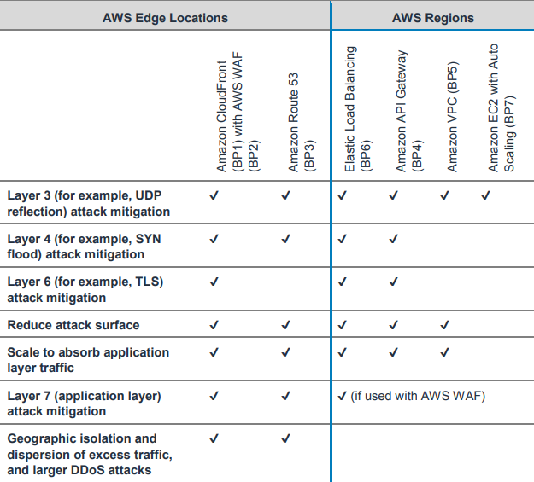
AWS Best Practices for DDoS Resiliency - Mitigation
https://d1.awsstatic.com/whitepapers/Security/DDoS_White_Paper.pdf
AWS Shield Standard → Available for all AWS services in all regions at no additional charge, ONLY PROTECTS AGAINST Layer 3 (Network) & 4 (Transport) attacks. DDoS attacks are detected by a system that automatically baselines traffic, identifies anomalies, and, as necessary, creates mitigations.
Use edge service like CloudFront & Route53 for:
AWS Shield DDoS mitigation systems that are integrated with AWS edge services, reducing time-to-mitigate from minutes to sub-second.
Stateless SYN Flood mitigation techniques that proxy and verify incoming connections before passing them to the protected service.
Automatic traffic engineering systems that can disperse or isolate the impact of large volumetric DDoS attacks.
Application layer defense when combined with AWS WAF that does not require changing your current application architecture (for example, in an AWS Region or on-premises datacenter).

Slide 4
AWS Best Practices for DDoS Resiliency
https://d1.awsstatic.com/whitepapers/Security/DDoS_White_Paper.pdf
AWS Shield Advanced →
This optional DDoS mitigation service helps you protect an application hosted on any AWS Region or hosted outside of AWS.
The service is available globally for Amazon CloudFront and Amazon Route 53.
It’s also available in select AWS Regions for CLB,ALB, and EIPs. Using AWS Shield Advanced with EIPs allows you to protect NLBs or EC2 instances.
With AWS Shield Advanced, you get the following additional benefits:
• Access to the AWS DRT for assistance in mitigating DDoS attacks that impact application availability.
• DDoS attack visibility by using the AWS Management Console, API, and Amazon CloudWatch metrics and alarms.
• Access to the Global Threat Environment dashboard, which provides an overview of DDoS attacks observed and mitigated by AWS.
• Access to AWS WAF, at no additional cost, for the mitigation of application layer DDoS attacks (when used with CloudFront or ALB).
• Automatic baselining of web traffic attributes, when used with AWS WAF.
• Access to AWS Firewall Manager, at no additional cost, for automated policy enforcement. This service lets security administrators centrally control and manage AWS WAF rules.
• Sensitive detection thresholds which routes traffic into DDoS mitigation system earlier and can improve time-to-mitigate attacks against Amazon EC2 or NLB, when used with EIP.
• Cost protection that allows you to request a limited refund of scaling-related costs that result from a DDoS attack.
• Enhanced service level agreement that is specific to AWS Shield Advanced customers.

Slide 5
AWS Best Practices for DDoS Resiliency
https://d1.awsstatic.com/whitepapers/Security/DDoS_White_Paper.pdf
BP1 | CloudFront | Use AWS WAF with Web ACLs to filter & block requests. Automatically block the IP addresses of bad actors using IP match conditions when requests matching a rule exceed a threshold that you define. Requests from offending client IP addresses will receive 403 Forbidden. Use AWS Firewall manager to manage WAF rules. Review your web server logs or use AWS WAF’s logging and Sampled Requests features. Cache static content and dynamic content using variable TTL. It accepts only well-formed requests thus avoiding SYN floods and UDP reflection attacks. Use OAI to protect static content in S3. Use Geo-restriction for whitelisting requests from specific countries. Use AWS DRT team to enable rules for mitigation based on requests. Prevents non-web traffic. Can automatically close connections from slow reading or slow writing attackers.
BP2 | CloudFront
BP3 | Route53 | Uses techniques like shuffle sharding and anycast striping, that can help users access your application even if the DNS service is targeted by a DDoS attack.
BP4 | API gateway | Recommendation is to use Regional Api endpoint (as against edge) enabled with AWS WAF. Forward all headers to API gateway to disable CF caching. Send the origin custom header “x-api-key” to protect APi gateway from direct access. Add rate limits.
BP5 | Sgroups & NACLs | All internet traffic to a security group is implicitly denied unless you create an allow rule to permit the traffic. E.g use SG to allow VPC traffic only from Cfront. Also, use Edge-to-origin request headers such as “X-Shared-Secret” to help validate that requests made to your origin were sent from CloudFront. Use NACLs and specify both allow and deny rules. If your application is used only for TCP traffic, you can create a rule to deny all UDP traffic, or vice versa. If using EIP, register it as protected resource for Shield advanced.
BP6 | Load balancing | For web applications, use ALB to route traffic based on its content and accept only well-formed web requests. This means that many common DDoS attacks, like SYN floods or UDP reflection attacks, will be blocked by ALB, protecting your application from the attack. For TCP-based applications, use NLB to route traffic to EC2 instances at ultra-low latency. When you create an NLB, a network interface is created for each AZ that you enable. You have the option to assign an EIP address per subnet enabled for the load balancer. One key consideration with NLB is that any traffic that reaches the load balancer on a valid listener will be routed to your EC2 instances, not absorbed.
BP7 | EC2 size AWS regions | Resize compute capacity to scale up as reqd. Use 25 gigabit nw interfaces and Enhanced nw Use appropriate regions and AZs

Slide 6
AWS Best Practices for DDoS Resiliency - monitoring & Reacting
https://d1.awsstatic.com/whitepapers/Security/DDoS_White_Paper.pdf
If you are subscribed to AWS Shield Advanced, you have access to a number of CloudWatch metrics that can indicate that your application is being targeted. Shield advanced metrics - DDoSDetected, DDoSAttackBitsPerSecond, DDoSAttackPacketsPerSecond, or DDoSAttackRequestsPerSecond
You can configure alarms to notify you when there is a DDoS attack in progress, so you can check your application’s health and decide whether to engage DRT. You can monitor these metrics by integrating CW with third-parties, such as Slack or PagerDuty.
An application layer attack can elevate many CW metrics. If you’re using AWS WAF, you can use CW to monitor and alarm on increases in requests that you’ve set in WAF to be allowed WAF metrics (AllowedRequests), counted (CountedRequests), or blocked (BlockedRequests). This allows you to receive a notification if the level of traffic exceeds what your application can handle.
AWS includes several additional metrics and alarms to notify you about an attack and to help you monitor your application’s resources. The AWS Shield console or API provide a summary and details about attacks that have been detected. In addition, the Global Threat Environment Dashboard provides summary information about all DDoS attacks that have been detected by AWS.
Another tool that can help you gain visibility into traffic that is targeting your application is VPC Flow Logs. Each flow log record includes the following: source and destination IP addresses, source and destination ports, protocol, and the number of packets and bytes transferred during the capture window. You can use this information to help identify anomalies in network traffic and to identify a specific attack vector

Slide 7
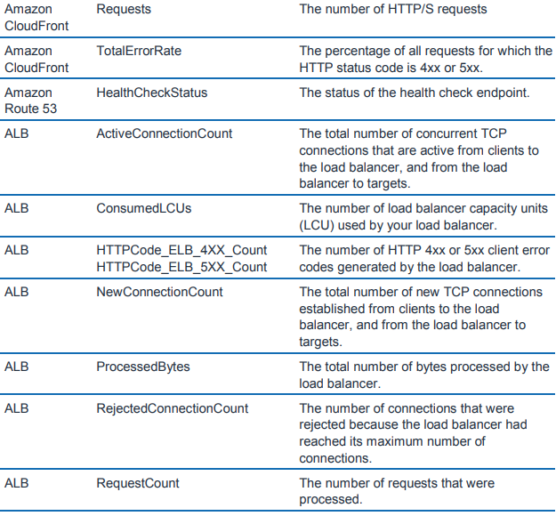
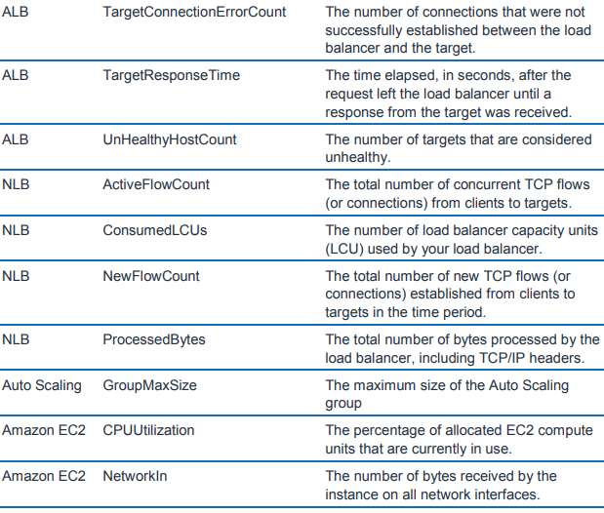
AWS Best Practices for DDoS Resiliency - Metrics
https://d1.awsstatic.com/whitepapers/Security/DDoS_White_Paper.pdf

Slide 8
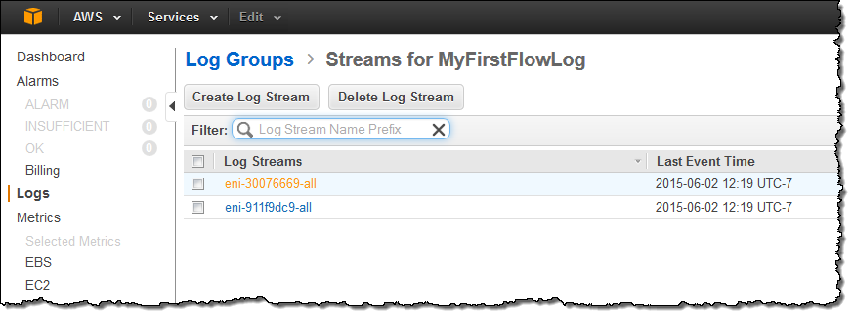
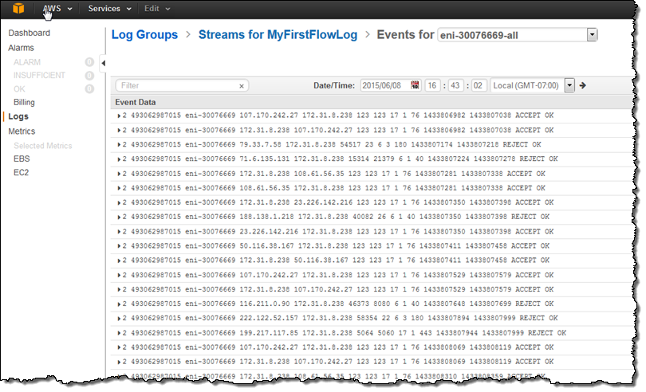
VPC Flow logs
https://aws.amazon.com/blogs/aws/vpc-flow-logs-log-and-view-network-traffic-flows/
Once enabled for a particular VPC, VPC subnet, or ENI, relevant network traffic will be logged to CloudWatch Logs. You can create alarms that will fire if certain types of traffic are detected; you can also create metrics to help you to identify trends and patterns.
The information captured includes information about allowed and denied traffic (based on security group and network ACL rules). Each flow log record includes the following: source and destination IP addresses, source and destination ports, IANA protocol, and the number of packets and bytes transferred during the capture window and an action (ACCEPT or REJECT).
Each CW log group will contain a separate stream for each ENI. Each stream, in turn, contains a series of flow log records. The Flow Logs will not include any of the following traffic:
Traffic to Amazon DNS servers, including queries for private hosted zones.
Windows license activation traffic for licenses provided by Amazon.
Requests for instance metadata.
DHCP requests or responses.

Slide 9
AWS Inspector
https://docs.aws.amazon.com/inspector/latest/userguide/inspector_introduction.html
Trusted Advisor gives counsel about your AWS Account in the regions of:
Cost Optimization, Fault Tolerance, Performance, Service Limits, Security
Trusted Advisor applies to the AWS account and AWS administrations, help customers follow general AWS best practices.
Amazon Inspector applies to the content of various EC2 occurrences. It is mostly about what happens on an instance: does the software conform to various best practises, patches installed etc.
Aws config rules are about resources. You can’t check what’s going on inside an instance but you could check that it’s running approved ami, has all of its volumes encrypted etc. There’s checks you can setup against lots of different types of resources.
Features of Amazon Inspector
Configuration scanning and activity monitoring engine – Amazon Inspector provides an agent that analyzes system and resource configuration. It also monitors activity to determine what an assessment target looks like, how it behaves, and its dependent components. The combination of this telemetry provides a complete picture of the target and its potential security or compliance issues.
Built-in content library – Amazon Inspector includes a built-in library of rules and reports. These include checks against best practices, common compliance standards, and vulnerabilities. The checks include detailed recommended steps for resolving potential security issues.
Automation through an API – Amazon Inspector can be fully automated through an API. This allows you to incorporate security testing into the development and design process, including selecting, executing, and reporting the results of those tests.
Amazon Inspector tests the network accessibility of your Amazon EC2 instances and the security state of your applications that run on those instances. Amazon Inspector assesses applications for exposure, vulnerabilities, and deviations from best practices. After performing an assessment, Amazon Inspector produces a detailed list of security findings that is organized by level of severity.
With Amazon Inspector, you can automate security vulnerability assessments throughout your development and deployment pipelines or for static production systems. This allows you to make security testing a regular part of development and IT operations.
Amazon Inspector also offers predefined software called an agent that you can optionally install in the operating system of the EC2 instances that you want to assess. The agent monitors the behavior of the EC2 instances, including network, file system, and process activity. It also collects a wide set of behavior and configuration data (telemetry).

Slide 10
IAM

Slide 11
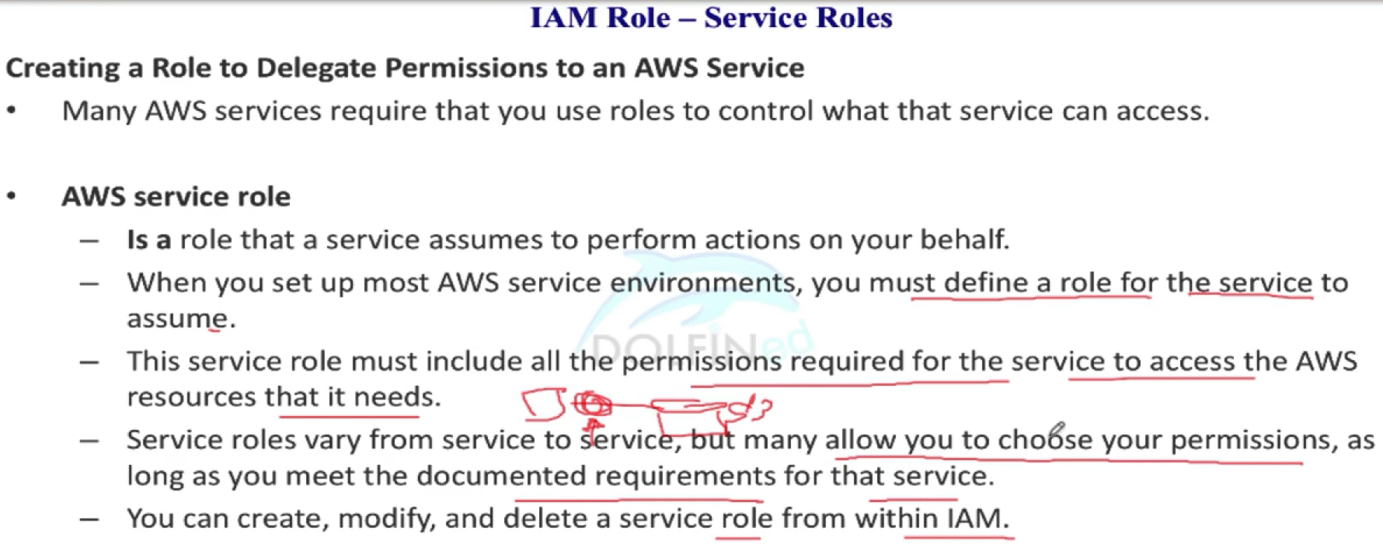
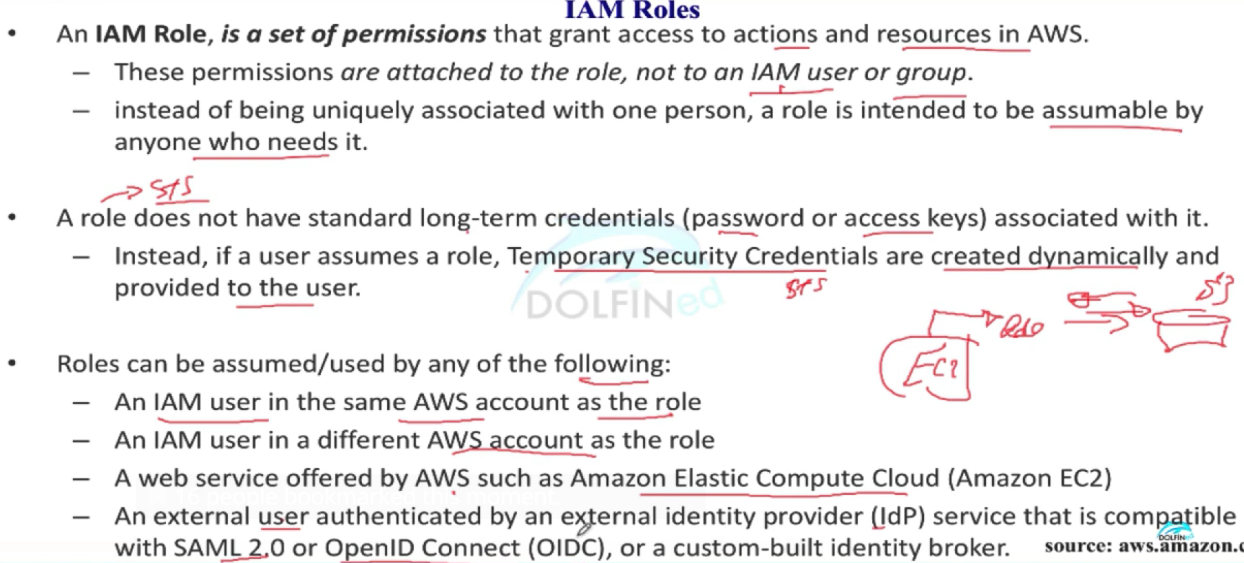
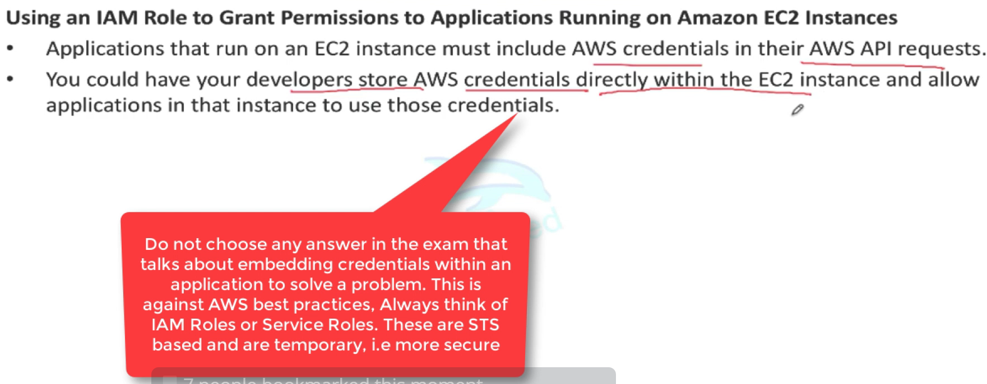
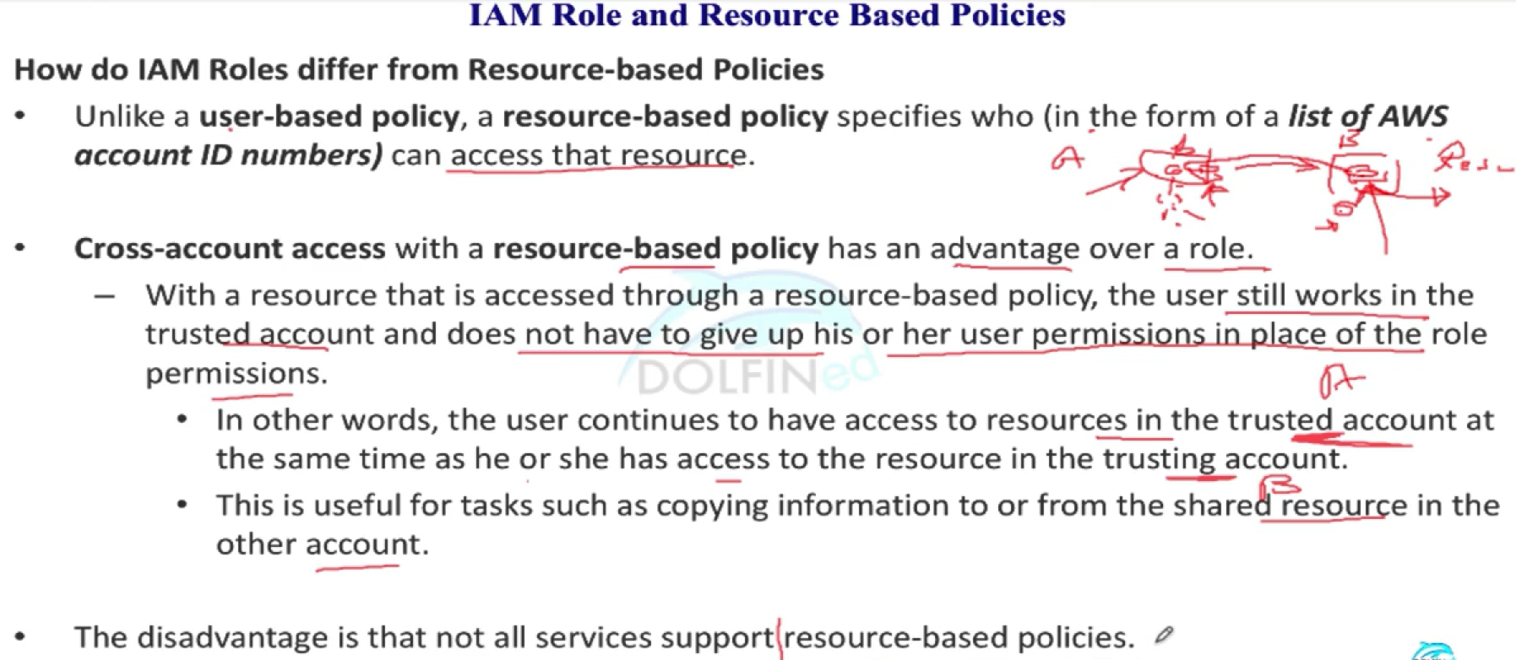
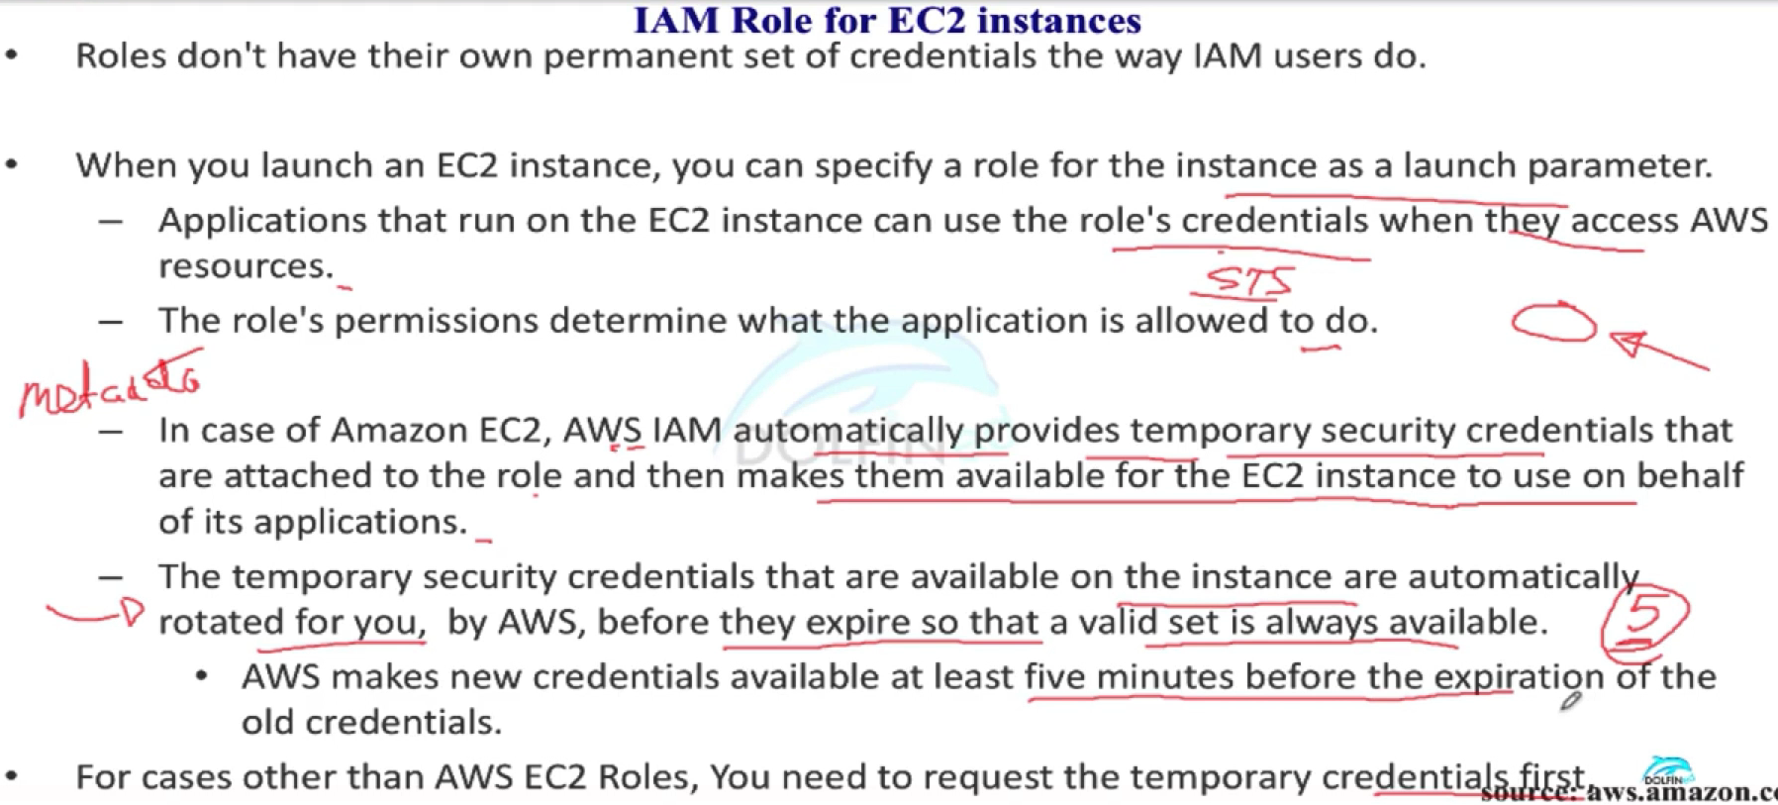
IAM Roles

Slide 12
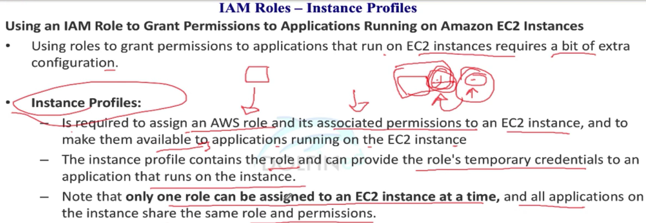
IAM - EC2 Instance Profiles
Roles are designed to be “assumed” by other principals which do define “who am I?”, such as users, Amazon services, and EC2 instances. An instance profile, on the other hand, defines “who am I?” Just like an IAM user represents a person, an instance profile represents EC2 instances. The only permissions an EC2 instance profile has is the power to assume a role.
So the EC2 instance runs under the EC2 instance profile, defining “who” the instance is. It then “assumes” the IAM role, which ultimately gives it any real power.
When you create an IAM Role for EC2 using the AWS Console, it creates both an EC2 instance profile as well as an IAM role.
However, if you are using the AWS CLI, SDKs, or CloudFormation, you will need to explicitly define both:
An IAM role with policies and permissions, and
An EC2 instance profile specifying which roles it can assume
E.g for EBeanStalk, the service role is assumed by EBS to use other AWS services on your behalf. The instance profile is applied to the instances in your environment and allows them to retrieve application versions from Amazon Simple Storage Service (Amazon S3), upload logs to Amazon S3, and perform other tasks that vary depending on the environment type and platform.

Slide 13
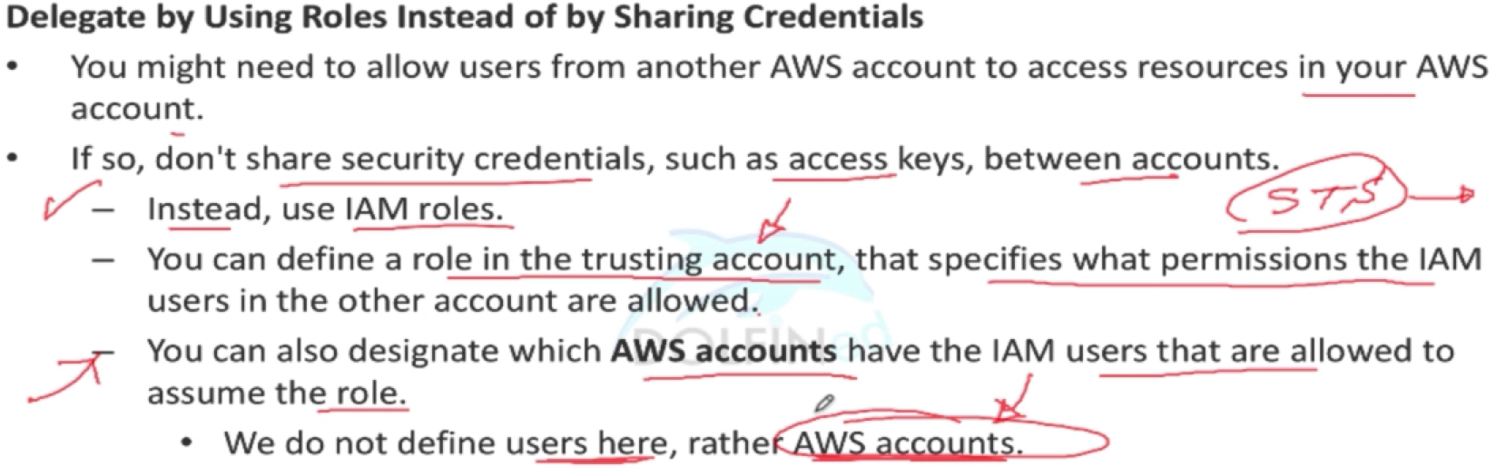
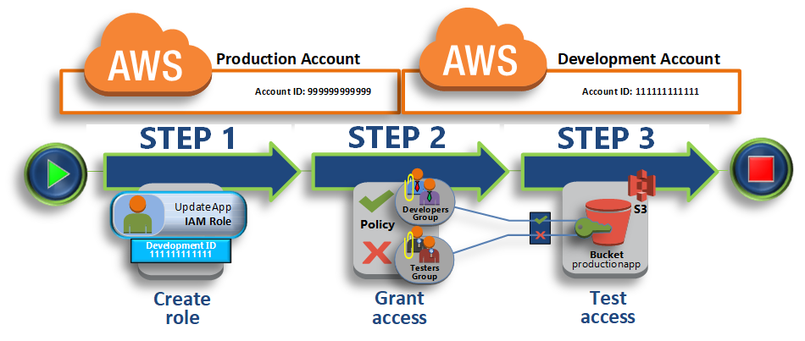
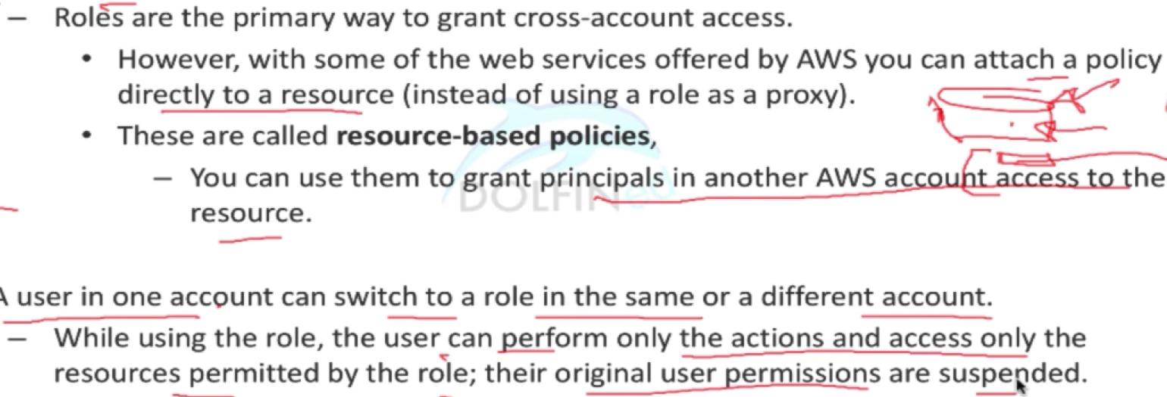
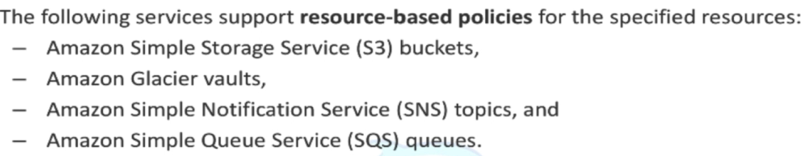
IAM - Cross Account Access
Use a role to delegate access to resources that are in different AWS accounts

Slide 14
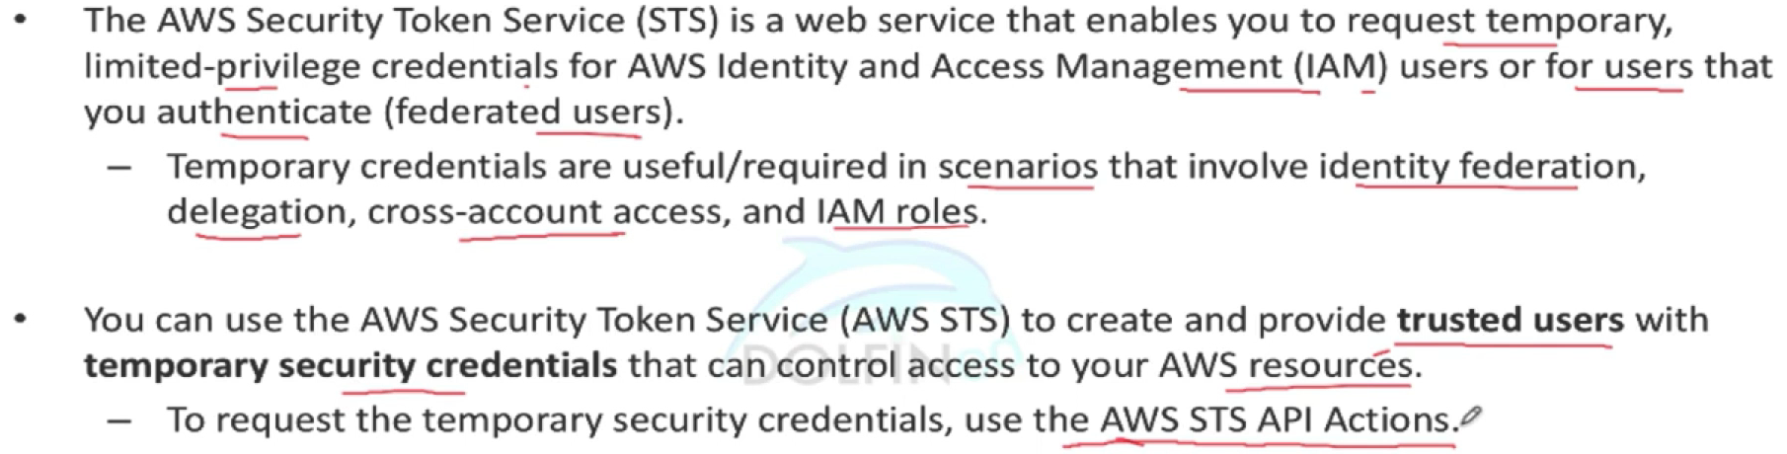
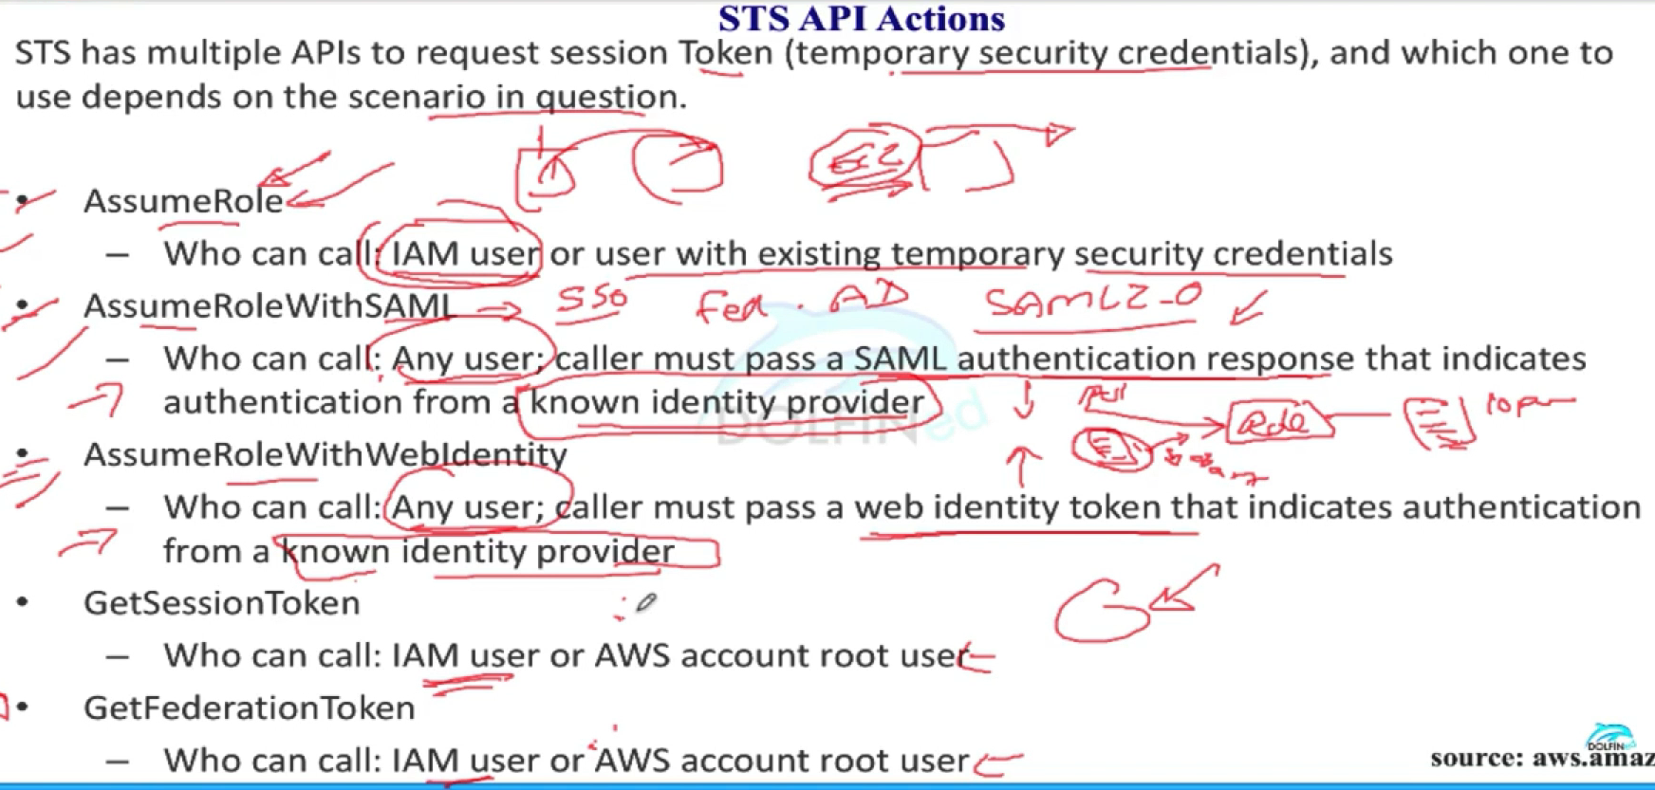
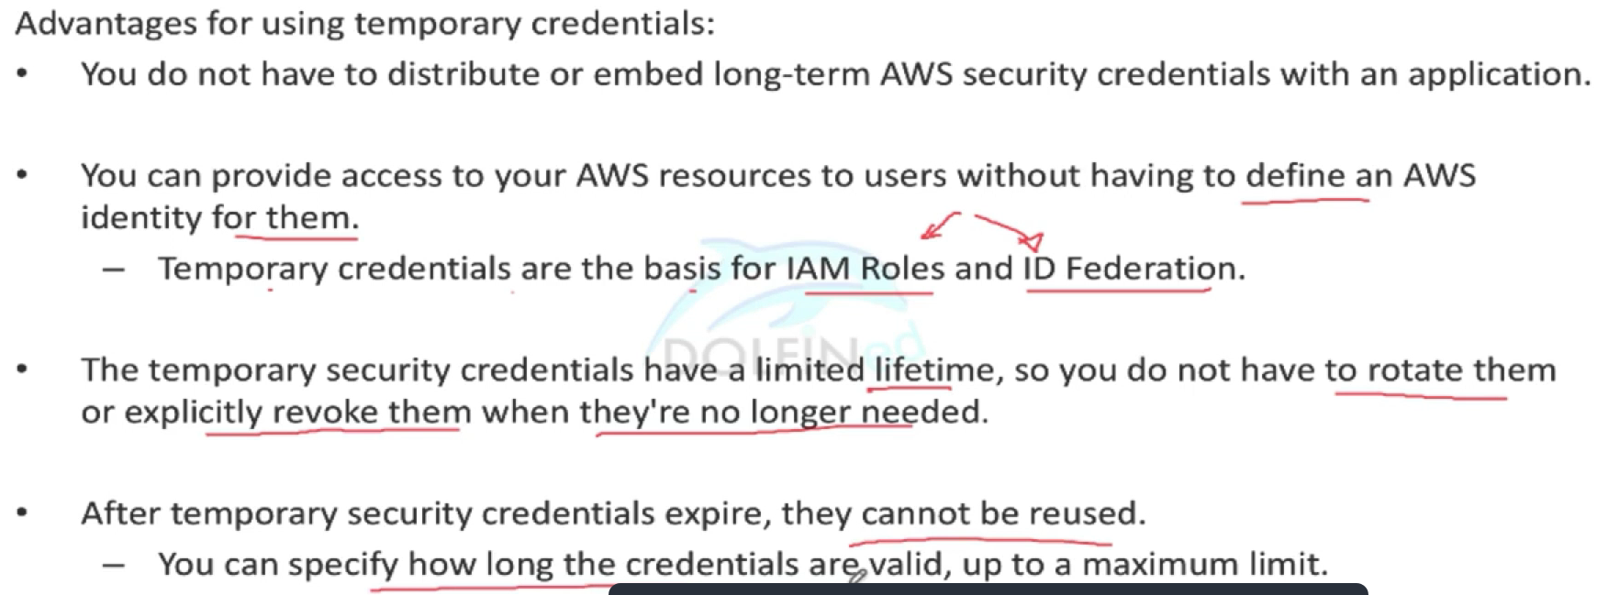
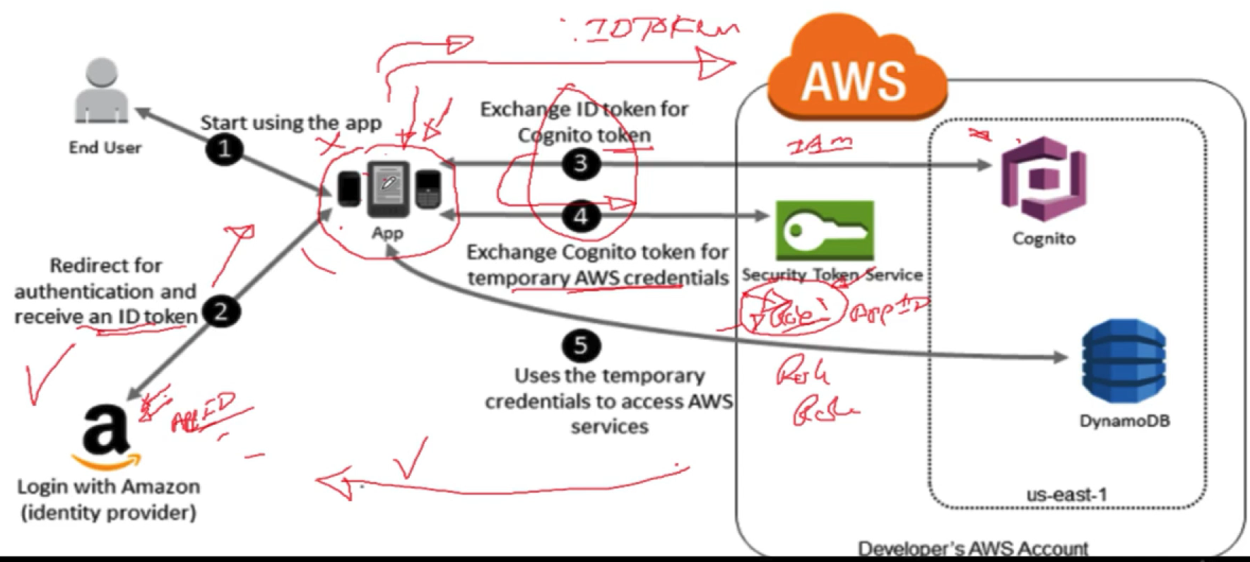
IAM - STS

Slide 15
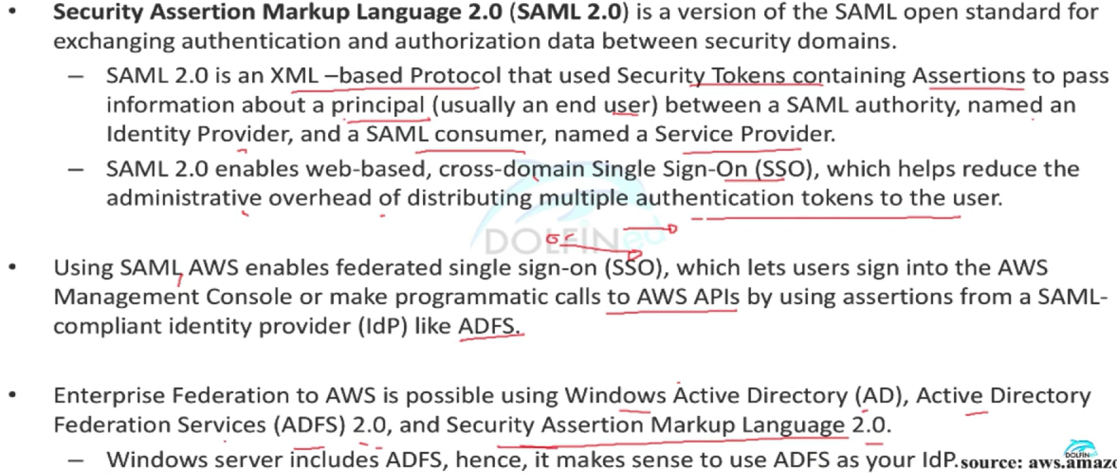
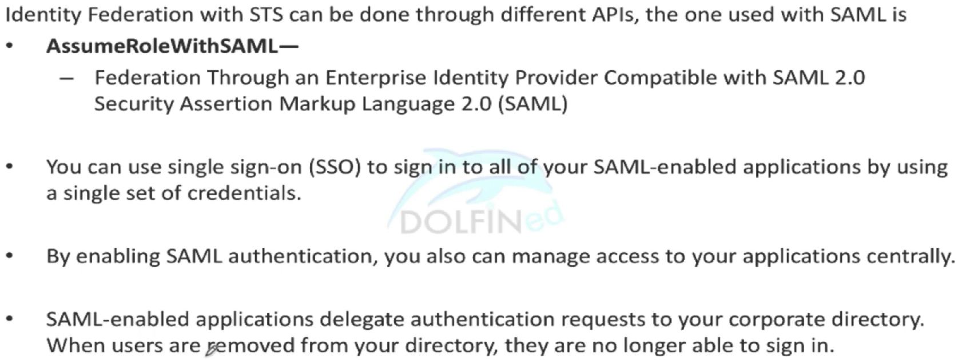
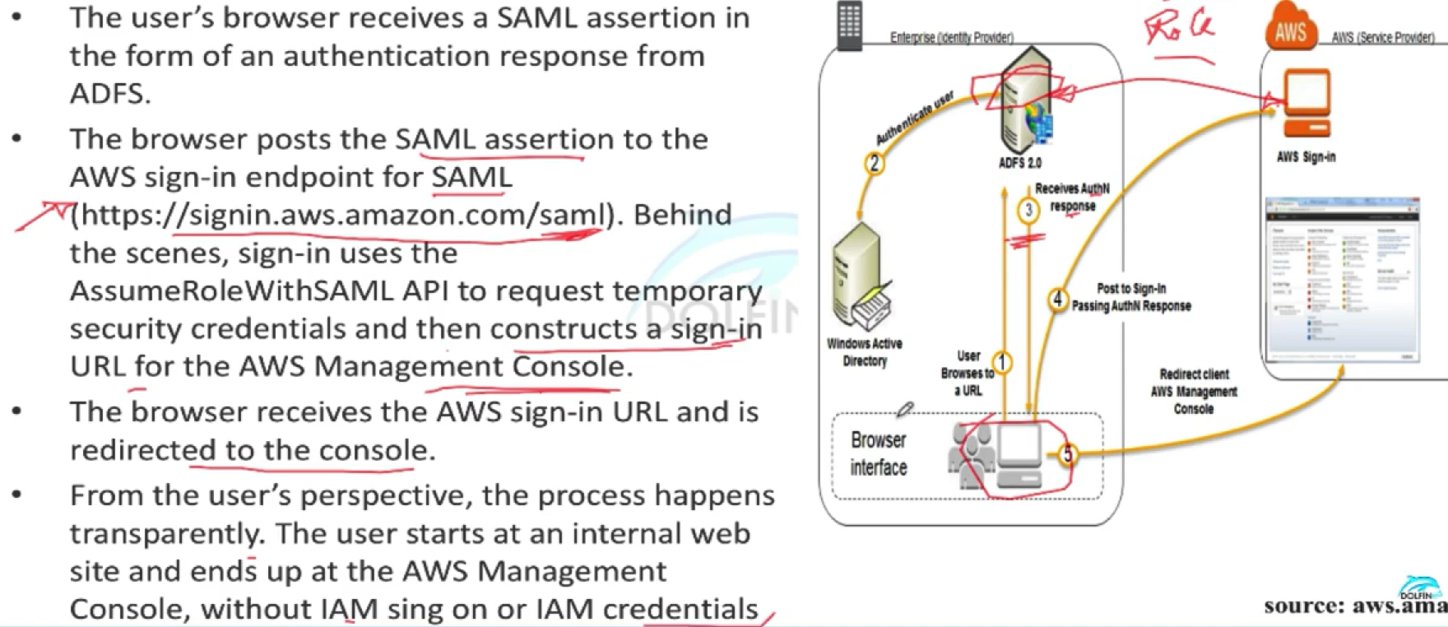
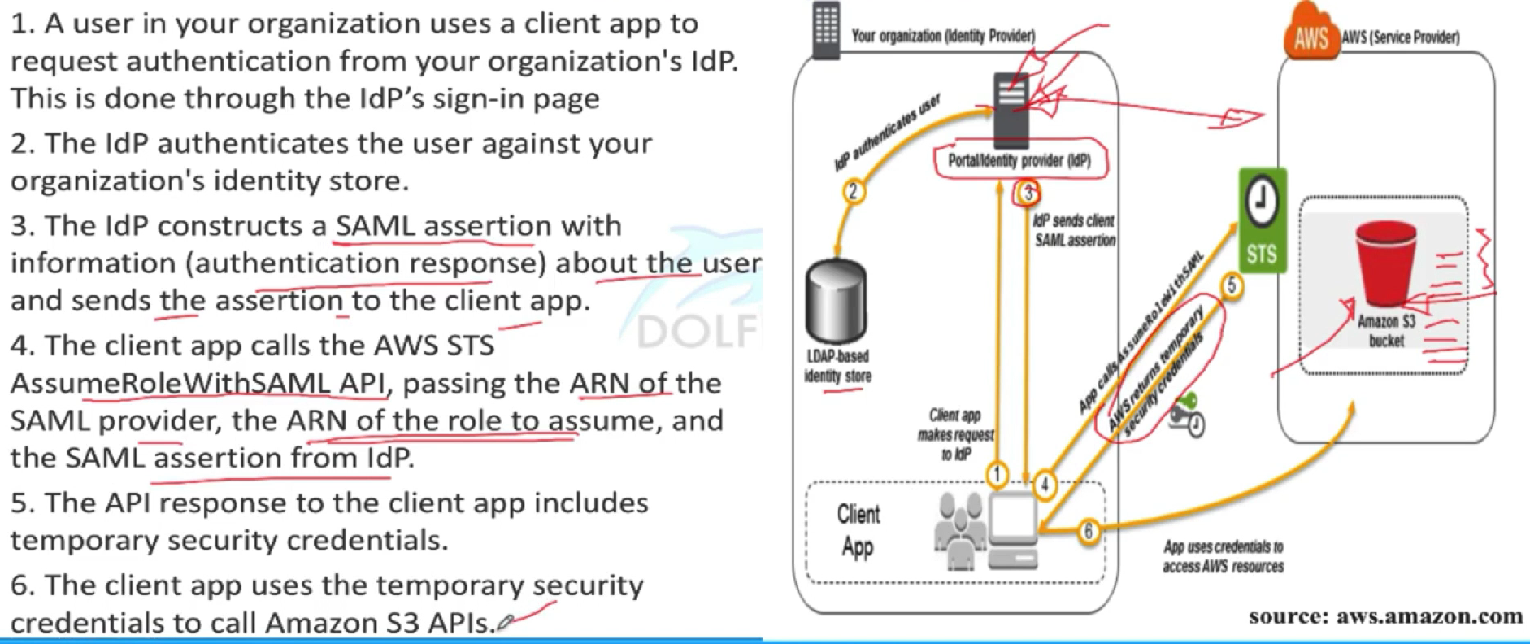
IAM - SAML Federation used for enterprise/corporate integrations
Accessing AWS Console from On-prem (SSO)
Accessing an AWS Service from On-prem

Slide 16
IAM - Scenarios
Person identity → Use IAM user credentials (Access key & Access secret)
Non-person (role) identities:
Mobile Apps → Web Identity Federation (AssumeRoleWithWebIdentity)
Corporate Sign in → SAML 2.0 Federated Access (AssumeRoleWithSAML)
Corporate Sign in without SAML → AssumeRole or GetFederationToken
EC2 accessing AWS services → AssumeRole (Instance Profile)
Need to send MFA code → GetSessionToken

Slide 17
Providing Access to Externally Authenticated Users (Identity Federation)
https://docs.aws.amazon.com/IAM/latest/UserGuide/id_roles_common-scenarios_federated-users.html
Your users might already have identities outside of AWS, such as in your corporate directory. If those users need to work with AWS resources (or work with applications that access those resources), then those users also need AWS security credentials. You can use an IAM role to specify permissions for users whose identity is federated from your organization or a third-party identity provider (IdP).
Federating Users of a Mobile or Web-based App with Amazon Cognito
If you create a mobile or web-based app that accesses AWS resources, the app needs security credentials in order to make programmatic requests to AWS. For most mobile application scenarios, we recommend that you use Amazon Cognito. Amazon Cognito also provides API operations for synchronizing user data so that it is preserved as users move between devices.
Federating Users with Public Identity Service Providers or OpenID Connect
Whenever possible, use Cognito for mobile and web-based application scenarios. Cognito does most of the behind-the-scenes work with public identity provider services for you. It works with the same third-party services and also supports anonymous sign-ins. However, for more advanced scenarios, you can work directly with a third-party service like Login with Amazon, Facebook, Google, or any IdP that is compatible with OpenID Connect (OIDC).
Federating users with SAML 2.0
If your organization already uses an identity provider software package that supports SAML 2.0 , you can create trust between your organization as an IdP and AWS as the service provider. You can then use SAML to provide your users with federated SSO to the AWS Mgmt Console or federated access to call AWS API operations.
Federating users by creating a custom identity broker application
If your identity store is not compatible with SAML 2.0, then you can build a custom identity broker application to perform a similar function. The broker application authenticates users, requests temporary credentials for users from AWS, and then provides them to the user to access AWS resources.

Slide 18
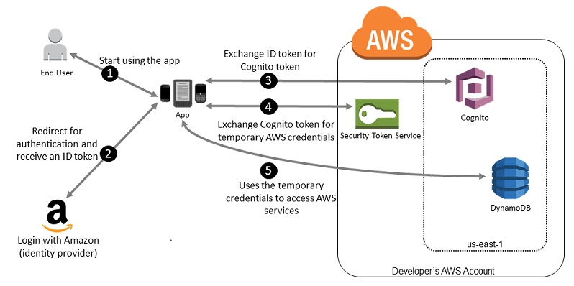
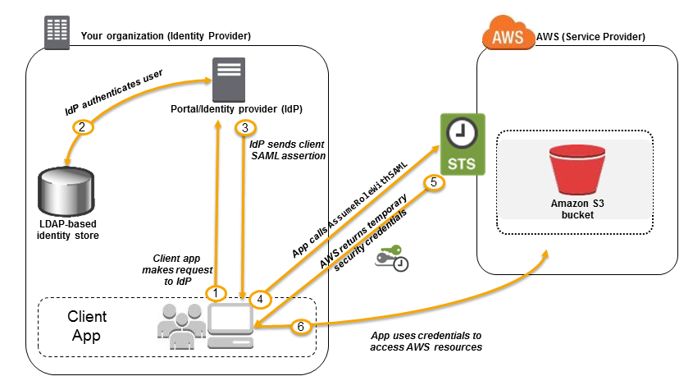
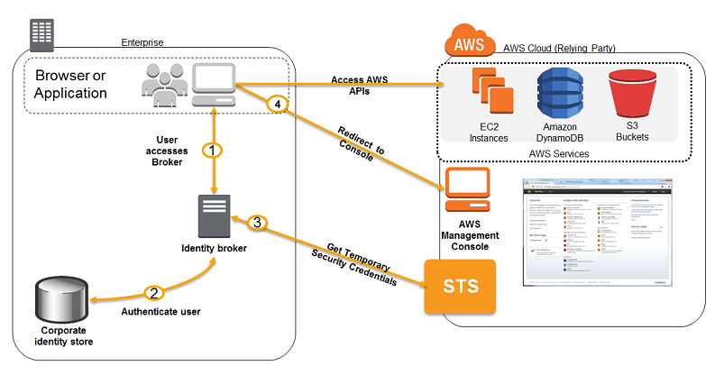
Using Amazon Cognito for Mobile Apps
Using SAML-Based Federation for API Access to AWS
Identifying Users with Web Identity Federation
"Effect": "Allow",
"Action": ["s3:ListBucket"],
"Resource": ["arn:aws:s3:::myBucket"],
"Condition": {"StringLike": {"s3:prefix": ["Amazon/mynumbersgame/${www.amazon.com:user_id}/*"]}}
Federating users by creating a custom identity broker application
{
"Version": "2012-10-17",
"Statement": {
"Effect": "Allow",
"Action": [
"s3:GetObject",
"s3:PutObject",
"s3:DeleteObject"
],
"Resource": [
"arn:aws:s3:::exampleorgBucket/backup/${saml:namequalifier}/${saml:sub}", "arn:aws:s3:::exampleorgBucket/backup/${saml:namequalifier}/${saml:sub}/*"
Uniquely Identifying Users in SAML-Based Federation

Slide 19
Requesting Temporary Security Credentials
https://docs.aws.amazon.com/IAM/latest/UserGuide/id_credentials_temp_request.html
AssumeRole—Cross-Account Delegation and Federation Through a Custom Identity Broker
The AssumeRole API operation is useful for allowing existing IAM users to access AWS resources that they don't already have access to, such as resources in another AWS account. It is also useful as a means to temporarily gain privileged access—for example, to provide multi-factor authentication (MFA). You must call this API using existing IAM user credentials.
AssumeRoleWithWebIdentity—Federation Through a Web-Based Identity Provider
The AssumeRoleWithWebIdentity API operation returns a set of temporary security credentials for federated users who are authenticated through a public identity provider. E.g. Amazon, Facebook, Google, or any OpenID Connect (OIDC)-compatible identity provider. This operation is useful for creating mobile applications or client-based web applications that require access to AWS. Using this operation means that your users do not need their own AWS or IAM identities.
AssumeRoleWithSAML—Federation Through an Enterprise Identity Provider Compatible with SAML 2.0
The AssumeRoleWithSAML API operation returns a set of temporary security credentials for federated users who are authenticated by your organization's existing identity system. The users must also use SAML 2.0 to pass authentication and authorization information to AWS. This API operation is useful in organizations that have integrated their identity systems (such as Windows AD or OpenLDAP) with software that can produce SAML assertions. Such an integration provides information about user identity and permissions (such as Active Directory Federation Services or Shibboleth).
GetFederationToken—Federation Through a Custom Identity Broker
The GetFederationToken API operation returns a set of temporary security credentials for federated users. This API differs from AssumeRole in that the default expiration period is substantially longer (12 hours instead of one hour). Additionally, you can use the DurationSeconds parameter to specify a duration for the temporary security credentials to remain valid. The resulting credentials are valid for the specified duration, between 900 seconds (15 minutes) to 129,600 seconds (36 hours).The longer expiration period can help reduce the number of calls to AWS because you do not need to get new credentials as often. When you make a request to get temporary security credentials for a federated user, you use the credentials of a specific user identity (an IAM user) to make the request.
GetSessionToken—Temporary Credentials for Users in Untrusted Environments
The GetSessionToken API operation returns a set of temporary security credentials to an existing IAM user. This is useful for providing enhanced security, such as allowing AWS requests only when MFA is enabled for the IAM user. Because the credentials are temporary, they provide enhanced security when you have an IAM user who accesses your resources through a less secure environment. Examples of less secure environments include a mobile device or web browser.

Slide 20
Requesting Temporary Security Credentials
https://docs.aws.amazon.com/IAM/latest/UserGuide/id_credentials_temp_request.html
AWS STS API | Who can call | Credential lifetime (min | max | default) | MFA support¹ | Session policy support²
AssumeRole | IAM user or IAM role with existing temporary security credentials | 15 m | Maximum session duration setting³ | 1 hr | Yes | Yes
AssumeRoleWithSAML | Any user; caller must pass a SAML authentication response that indicates authentication from a known identity provider | 15 m | Maximum session duration setting³ | 1 hr | No | Yes
AssumeRoleWithWebIdentity | Any user; caller must pass a web identity token that indicates authentication from a known identity provider | 15 m | Maximum session duration setting³ | 1 hr | No | Yes
GetFederationToken | IAM user or AWS account root user | IAM user: 15 m | 36 hr | 12 hr Root user: 15 m | 1 hr | 1 hr | No | Yes
GetSessionToken | IAM user or AWS account root user | IAM user: 15 m | 36 hr | 12 hr Root user: 15 m | 1 hr | 1 hr | Yes | No
Session policies are advanced policies that you pass as parameters when you programmatically create a temporary session. When you create a federated user session and pass session policies, the resulting session's permissions are the intersection of the IAM user's identity-based policy and the session policies. You cannot use the session policy to grant more permissions than those allowed by the identity-based policy of the user that is being federated.

Slide 21
Providing Access to AWS Accounts Owned by Third Parties
When third parties require access to your organization's AWS resources, you can use roles to delegate access to them. For example, a third party might provide a service for managing your AWS resources. With IAM roles, you can grant these third parties access to your AWS resources without sharing your AWS security credentials. Instead, the third party can access your AWS resources by assuming a role that you create in your AWS account.
Third parties must provide you with the following information for you to create a role that they can assume:
The third party's AWS account ID. You specify their AWS account ID as the principal when you define the trust policy for the role.
An external ID to uniquely associate with the role. The external ID can be any secret identifier that is known by you and the third party. For example, you can use an invoice ID between you and the third party, but do not use something that can be guessed, like the name or phone number of the third party. You must specify this ID when you define the trust policy for the role. The third party must provide this ID when they assume the role. For more information about the external ID, see How to Use an External ID When Granting Access to Your AWS Resources to a Third Party.
The permissions that the third party requires to work with your AWS resources. You must specify these permissions when defining the role's permission policy. This policy defines what actions they can take and what resources they can access.
After you create the role, you must provide the role's Amazon Resource Name (ARN) to the third party. They require your role's ARN in order to assume the role.

Slide 22
AWS Directory Service
(AWS MS AD)

Slide 23
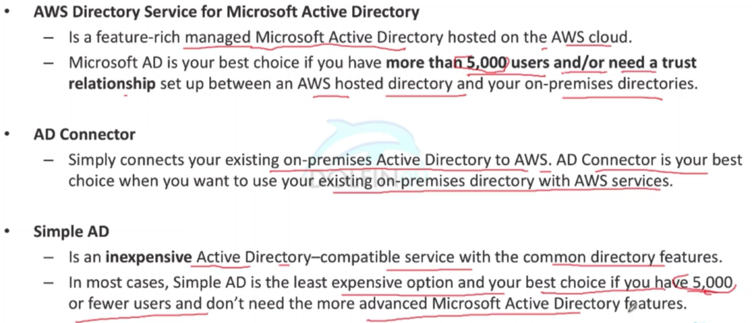
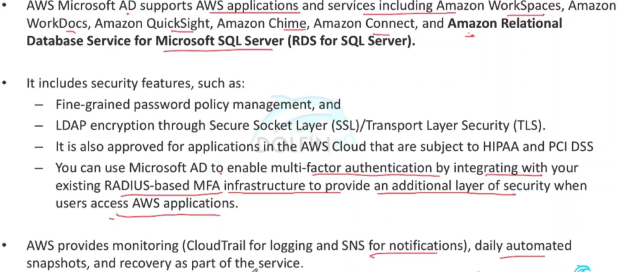
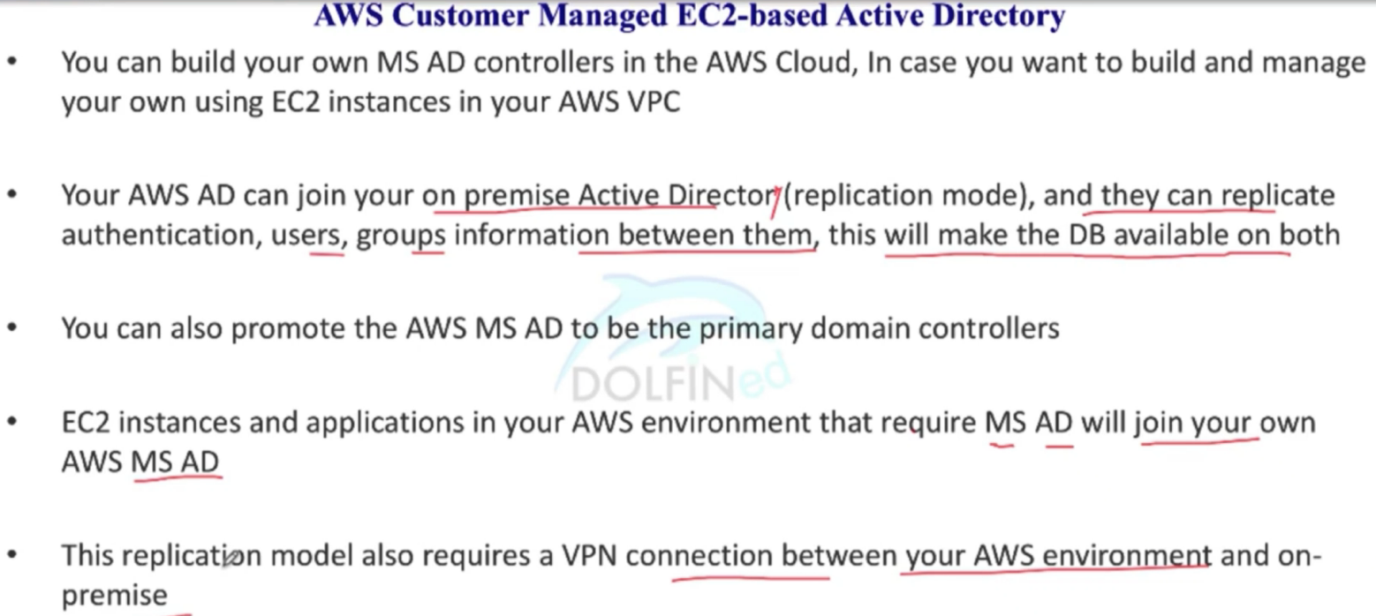
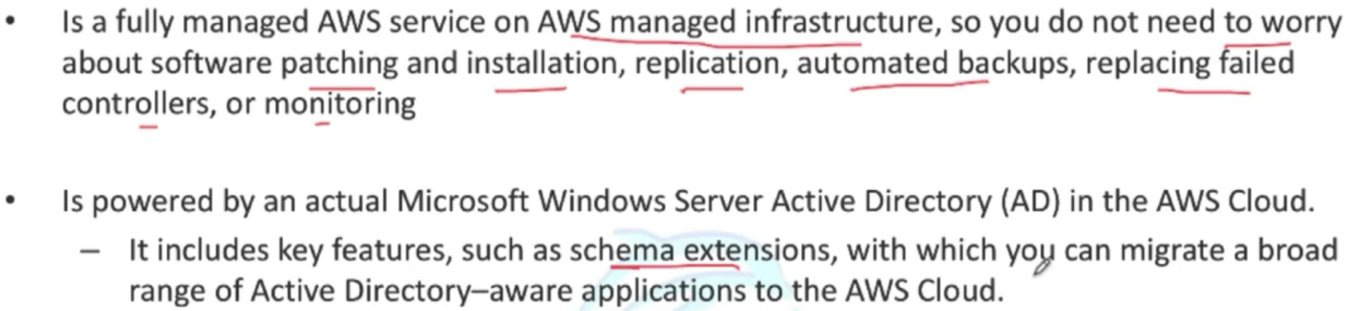
Aws ms ad - Intro
MSAD does not support replication mode when connecting to your on-prem AD, only Trust relationship is supported

Slide 24
KMS

Slide 25
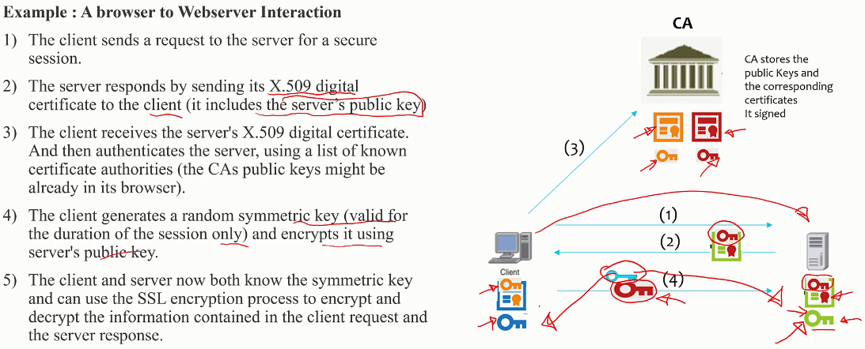
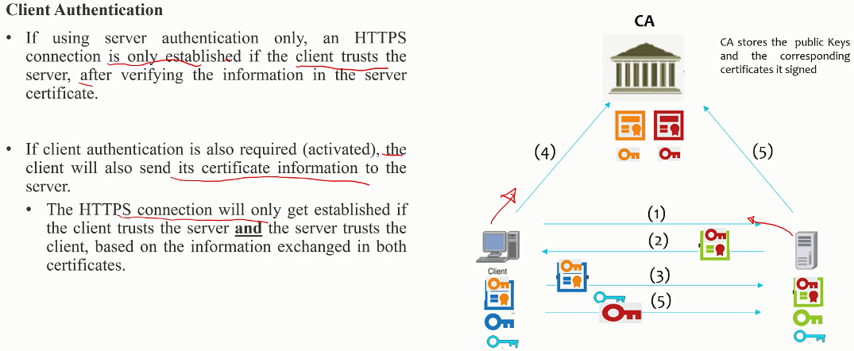
Cryptography- Concepts
2 types - Public key or Asymmetric cryptography (PKCS) and Symmetric key cryptography
Browser based applications interact with server with PKCS protocol
AWS KMS uses symmetric key encryption which is more efficient than PKE
To request a certificate:
Entity needs to submit a Certificate Signing request (CSR) to CA
The CSR itself is SIGNED using the entity’s private key
CA uses the entity’s public key to identify the entity and its ownership of the public key
If signature is validated, CA issues the certificate and signs it with it’s private key, binding the public key to the Distinguished name (Entity requesting the certificate)
All browsers are bundled with prominent CA’s public keys which enables it to validate server certificates
Certificate chains:
All major CA’s appoint 3rd party/resellers to sign certificates, in this case the entity’s SSL certificate must be signed with both the root and all intermediate CA’s. During certificate validation, the entire chain is validated from the SSL certificate → Intermediate CA → Root CA

Slide 26
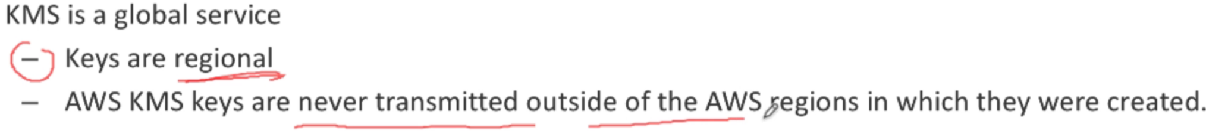
Kms - Concepts
A managed service that makes it easy for you to create and control the encryption keys used to encrypt your data. You can perform the following actions on your AWS KMS master keys:
Create, describe, and list master keys
Enable and disable master keys
Create and view grants and access control policies for your master keys
Enable and disable automatic rotation of the cryptographic material in a master key
Import cryptographic material into an AWS KMS master key
Tag your master keys for easier identification, categorizing, and tracking
Create, delete, list, and update aliases, which are friendly names associated with your master keys
Delete master keys to complete the key lifecycle
With AWS KMS you can also perform the following cryptographic functions using master keys:
Encrypt, decrypt, and re-encrypt data
Generate data encryption keys that you can export from the service in plaintext or encrypted under a master key that doesn't leave the service
Generate random numbers suitable for cryptographic application

Slide 27
Kms - Concepts
Customer Master Keys (CMKs):
Customer master keys are the primary resources in AWS KMS
A customer master key (CMK) is a logical representation of a master key.
The CMK includes metadata, such as the key ID, creation date, description, and key state.
The CMK also contains the key material used to encrypt and decrypt data.
You can use a CMK to encrypt and decrypt up to 4 KB (4096 bytes) of data.
Typically, you use CMKs to generate, encrypt, and decrypt the data keys that you use outside of AWS KMS to encrypt your data. This strategy is known as envelope encryption.
CMKs are created in AWS KMS and never leave AWS KMS unencrypted.
Some services use CMK others use AWSMgK others give a choice, e.g. EBS provides a choice
A default Master CMK specific to each service is created in your account as a convenience the first time you try to create and encrypted resource
Alternatively you can create a custom master key to use in your own appl or from a aws service
Data Keys:
Data keys are encryption keys that you can use to encrypt data, including large amounts of data and other data encryption keys. You can use CMKs to generate, encrypt, and decrypt data keys. However, KMS does not store, manage, or track your data keys, or perform cryptographic operations with data keys. You must use and manage data keys outside of KMS.
Type of CMK | Can view CMK metadata | Can manage CMK | Used only for my AWS account
Customer managed CMK | Yes | Yes | Yes
AWS managed CMK (used by AWS services automatically such as S3, EBS etc. identifiable by aws/s3, aws/redshift etc) | Yes | No | Yes
AWS owned CMK | No | No | No

Slide 28
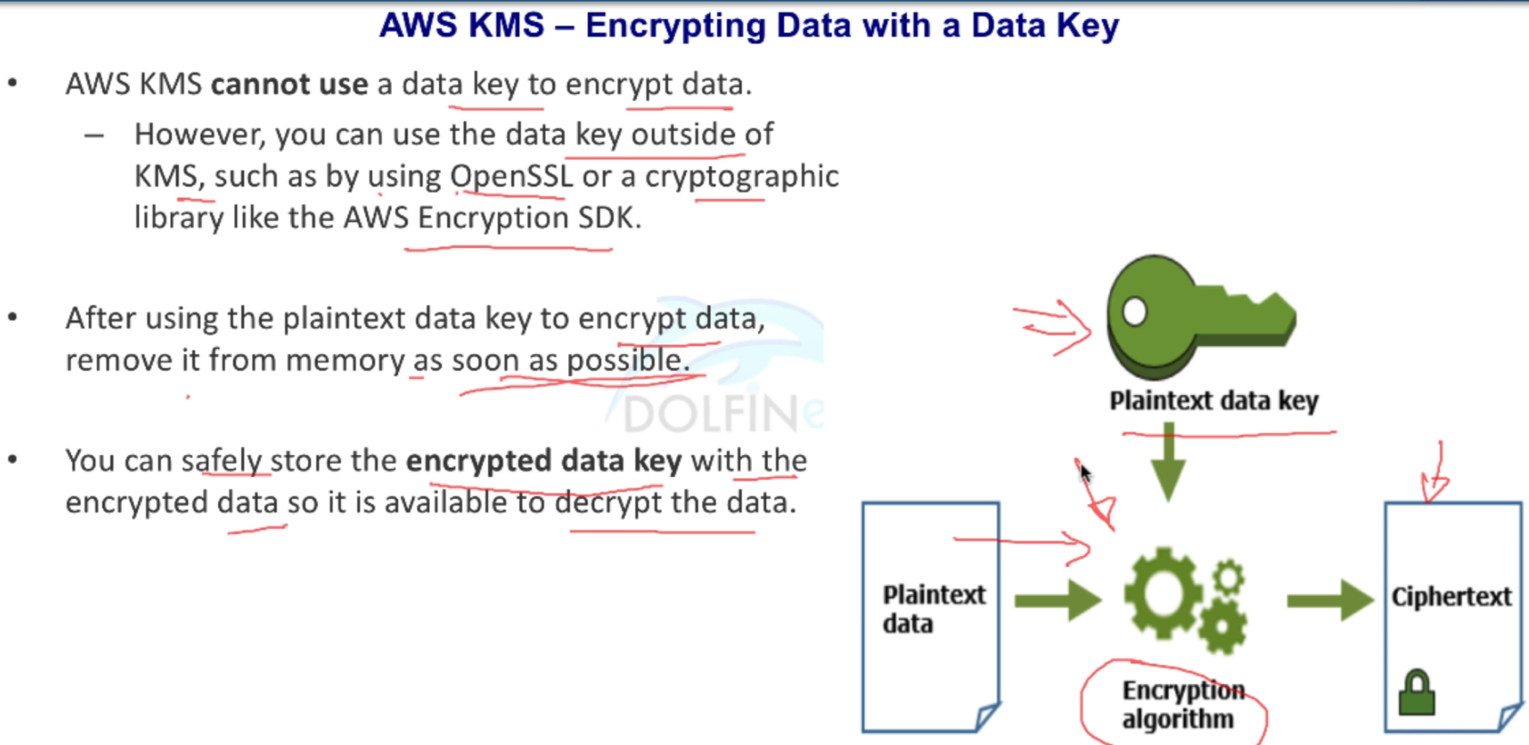
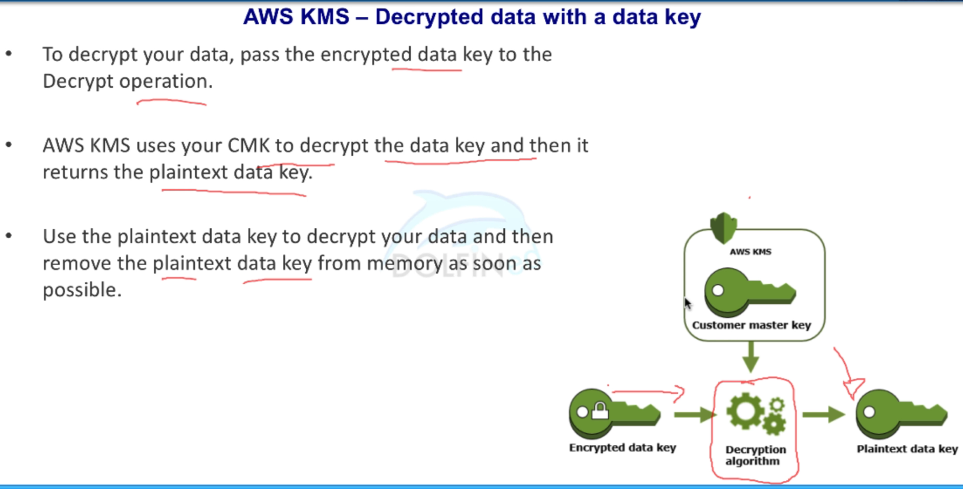
Kms - Using Data Key

Slide 29
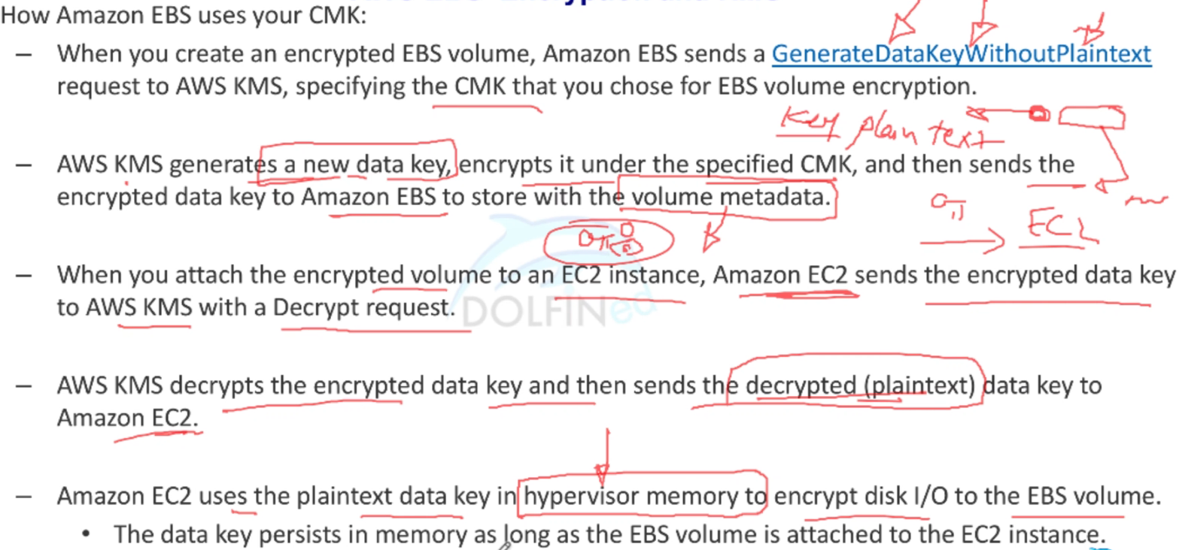
How EBS Uses KMS
EBS encryption
When you attach an encrypted EBS volume to a supported EC2 instance type, data stored at rest on the volume, disk I/O, and snapshots created from the volume are all encrypted.
The encryption occurs on the servers that host Amazon EC2 instances.
This feature is supported on all Amazon EBS volume types.
You access encrypted volumes the same way you access other volumes; encryption and decryption are handled transparently and they require no additional action from you, your EC2 instance, or your application.
Snapshots of encrypted volumes are automatically encrypted, and volumes that are created from encrypted snapshots are also automatically encrypted.
The encryption status of an EBS volume is determined when you create the volume. You cannot change the encryption status of an existing volume. However, you can migrate data between encrypted and unencrypted volumes and apply a new encryption status while copying a snapshot.
Using CMKs and Data Keys:
When you create an encrypted EBS volume, you specify an KMS customer master key (CMK). By default, EBS uses the AWS managed CMK for Amazon EBS in your account. However, you can specify a customer managed CMK. EBS uses the CMK that you specify to generate a unique data key for each volume. It stores an encrypted copy of the data key with the volume. Then, when you attach the volume to an Amazon EC2 instance, EBS uses the data key to encrypt all disk I/O to the volume.

Slide 30
CloudHSM

Slide 31
CloudHSM - Concepts
AWS CloudHSM provides hardware security modules in the AWS Cloud. A hardware security module (HSM) is a computing device that processes cryptographic operations and provides secure storage for cryptographic keys. When you use an HSM from AWS CloudHSM, you can perform a variety of cryptographic tasks:
Generate, store, import, export, and manage cryptographic keys, including symmetric keys and asymmetric key pairs.
Use symmetric and asymmetric algorithms to encrypt and decrypt data.
Use cryptographic hash functions to compute message digests and (HMACs).
Cryptographically sign data (including code signing) and verify signatures.
Generate cryptographically secure random data.
If you want a managed service for creating and controlling your encryption keys, but you don't want or need to operate your own HSM, consider using AWS Key Management Service.
Lambda authorizers

Slide 32
CloudHSM - Use Cases
Offload the SSL/TLS Processing for Web Servers:
Web servers and their clients (web browsers) can use SSL or TLS. The web server uses a public–private key pair and an SSL/TLS public key certificate to establish an HTTPS session with each client. This process involves a lot of computation for the web server, but you can offload some of this to the HSMs in your AWS CloudHSM cluster. This is sometimes known as SSL acceleration. Offloading reduces the computational burden on your web server and provides extra security by storing the server's private key in the HSMs.
Protect the Private Keys for an Issuing Certificate Authority (CA):
In a public key infrastructure (PKI), a certificate authority (CA) is a trusted entity that issues digital certificates. These digital certificates bind a public key to an identity (a person or organization) by means of public key cryptography and digital signatures. To operate a CA, you must maintain trust by protecting the private key that signs the certificates issued by your CA. You can store the private key in the HSM in your AWS CloudHSM cluster, and use the HSM to perform the cryptographic signing operations.
Enable Transparent Data Encryption (TDE) for Oracle Databases:
Some versions of Oracle's database software offer a feature called Transparent Data Encryption (TDE). With TDE, the database software encrypts data before storing it on disk. The data in the database's table columns or tablespaces is encrypted with a table key or tablespace key. These keys are encrypted with the TDE master encryption key. You can store the TDE master encryption key in the HSMs in your AWS CloudHSM cluster, which provides additional security.
Lambda authorizers

Slide 33
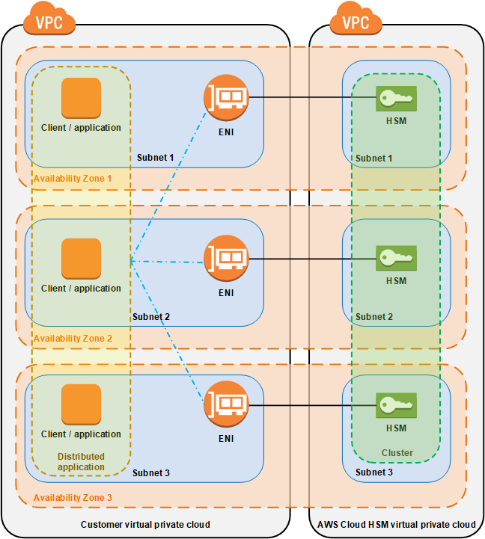
CloudHSM - Cluster Architecture
Each time you create an HSM, you specify the cluster and Availability Zone for the HSM. By putting the HSMs in different Availability Zones, you achieve redundancy and high availability in case one Availability Zone is unavailable.
When you create an HSM, AWS CloudHSM puts an elastic network interface (ENI) in the specified subnet in your AWS account. The elastic network interface is the interface for interacting with the HSM.
The HSM resides in a separate VPC in an AWS account that is owned by AWS CloudHSM. The HSM and its corresponding network interface are in the same Availability Zone.
To interact with the HSMs in a cluster, you need the AWS CloudHSM client software. Typically you install the client on Amazon EC2 instances, known as client instances, that reside in the same VPC as the HSM ENIs, as shown in the following figure. That's not technically required though; you can install the client on any compatible computer, as long as it can connect to the HSM ENIs. The client communicates with the individual HSMs in your cluster through their ENIs.
Lambda authorizers

Slide 34
CloudHSM - HSM Users
Precrypto Officer (PRECO)
The PRECO is a temporary user that exists only on the first HSM in an AWS CloudHSM cluster. Used for activiating the cluster, the PRECO user becomes a crypto officer (CO).
Crypto Officer (CO)
A CO can perform user mgmt operations. eg. a CO can create and delete users and change user passwords.
Crypto User (CU)
A CU can perform the following key management and cryptographic operations.
Key management – Create, delete, share, import, and export cryptographic keys.
Cryptographic operations – Use cryptographic keys for encryption, decryption, signing, verifying, and more.
Appliance User (AU)
The AU can perform cloning and synchronization operations. AWS CloudHSM uses the AU to synchronize the HSMs in an AWS CloudHSM cluster. The AU exists on all HSMs provided by AWS CloudHSM, and has limited permissions.
 | Crypto Officer (CO) | Crypto User (CU) | Appliance User (AU) | Unauthenticated User
Get basic cluster info¹ | Yes | Yes | Yes | Yes
Zeroize an HSM² | Yes | Yes | Yes | Yes
Change own password | Yes | Yes | Yes | Not applicable
Change any user's password | Yes | No | No | No
Add, remove users | Yes | No | No | No
Get sync status³ | Yes | Yes | Yes | No
Extract, insert masked objects⁴ | Yes | Yes | Yes | No
Key management functions⁵ | No | Yes | No | No
Encrypt, decrypt | No | Yes | No | No
Sign, verify | No | Yes | No | No
Generate digests and HMACs | No | Yes | No | No

Slide 35
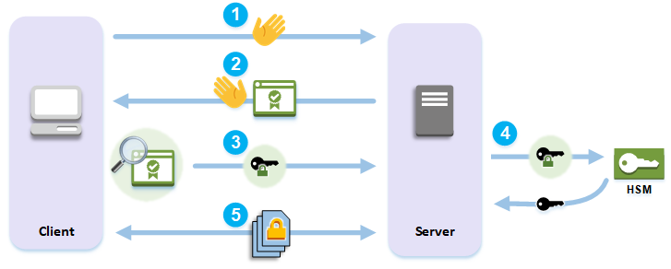
Improve Your Web Server's Security with SSL/TLS Offload in AWS CloudHSM
The client sends a hello message to the server.
The server responds with a hello message and sends the server's certificate.
The client performs the following actions:
Verifies that the SSL/TLS server certificate is signed by a root certificate that the client trusts.
Extracts the public key from the server certificate.
Generates a premaster secret and encrypts it with the server's public key.
Sends the encrypted premaster secret to the server.
To decrypt the client's premaster secret, the server sends it to the HSM. The HSM uses the private key in the HSM to decrypt the premaster secret and then it sends the premaster secret to the server. Independently, the client and server each use the premaster secret and some information from the hello messages to calculate a master secret.
The handshake process ends. For the rest of the session, all messages sent between the client and the server are encrypted with derivatives of the master secret.

Slide 36
waf

Slide 37
AWS WAF can be applied to APIG, ALB or CF
At the simplest level, AWS WAF lets you choose one of the following behaviors:
Allow all requests except the ones that you specify
Block all requests except the ones that you specify
Count the requests that match the properties that you specify
Additionally:
Define conditions by using characteristics of web requests such as the following:
IP addresses that requests originate from, Country that requests originate from, Values in request headers, Strings that appear in requests, either specific strings or string that match regular expression (regex) patterns, Length of requests, Presence of SQL code that is likely to be malicious (known as SQL injection), XSS
Rules that can allow, block, or count web requests that meet the specified conditions. Alternatively, rules can block or count web requests that not only meet the specified conditions, but also exceed a specified number of requests in any 5-minute period.
Rules that you can reuse for multiple web applications.
Real-time metrics and sampled web requests.
Automated administration using the AWS WAF API
AWS Shield
You can use AWS WAF web access control lists (web ACLs) to help minimize the effects of a DDoS attack. For additional protection against DDoS attacks, AWS provides AWS Shield Standard & Advanced. AWS Shield Advanced provides expanded DDoS attack protection for your Amazon EC2 instances, Elastic Load Balancing load balancers, CloudFront distributions, and Route 53 hosted zones. AWS Shield Advanced incurs additional charges.
Lambda authorizers

Slide 38
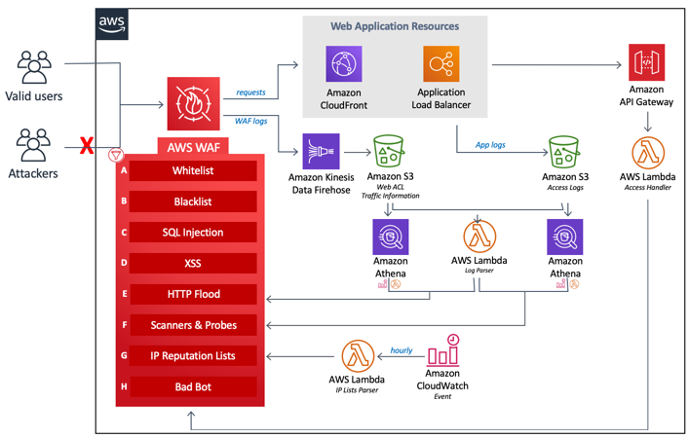
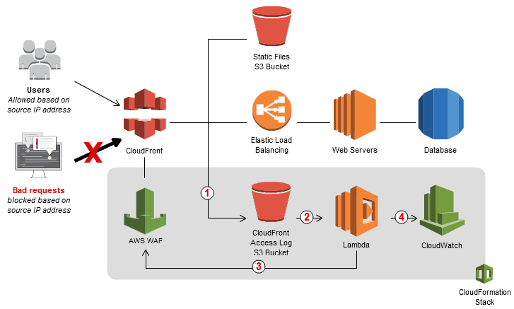
AWS WAF can be applied to APIG, ALB or CF
Types of implementations:
Custom - WAF Security Automation
AWS offers a solution that uses AWS CloudFormation to automatically deploy a set of AWS WAF rules designed to filter common web-based attacks. Users can select from preconfigured protective features that define the rules included in an AWS WAF web access control list (web ACL). Once the solution is deployed, AWS WAF will begin inspecting web requests to the user’s existing Amazon CloudFront distributions or Application Load Balancers, and block
them when applicable.
2. Custom - Blocking IP addresses that submit bad requests
Using AWS Lambda, you can set a threshold of how many bad requests per minute your web application will tolerate from a given IP address. A bad request is one for which your CloudFront origin returns one of the HTTP 40x status codes: 400, Bad Request 403, Forbidden 404, Not Found 405, Method Not Allowed
If users (based on IP addresses) exceed this error code threshold, Lambda automatically updates your AWS WAF rules to block IP addresses and specify for how long requests from those IP addresses should be blocked.
3. Managed rules for WAF
Pre-configured rules from 3rd party security sellers. Can be applied in addition to custom rules
Lambda authorizers

Slide 39
Difference b/w Shield Standard and Shield Advanced
https://aws.amazon.com/shield/getting-started
Feature (only differences) | Shield Standard | Shield Advanced
Monitoring - Application traffic monitoring | No | Yes
Mitigations - Additional DDoS mitigation capacity for large attacks | No | Yes
Mitigations - DRT-driven application layer (Layer 7) mitigations | No | Yes with DRT response team
Visibility - Layer 3/Layer 4 attack notification Visibility - Layer 7 attack notification Visibility - Layer 3/Layer 4/ Layer 7 attack historical report | No | Yes
DRT Support - Custom mitigations during attacks DRT Support - Post attack analysis | No | Yes
DDoS Cost Protection (Service credits for DDoS scaling charges) R53, CloudFront, ELB, EC2 | No | Yes
Cost Monthly, Usage-based , SLA | No | Yes

Slide 40
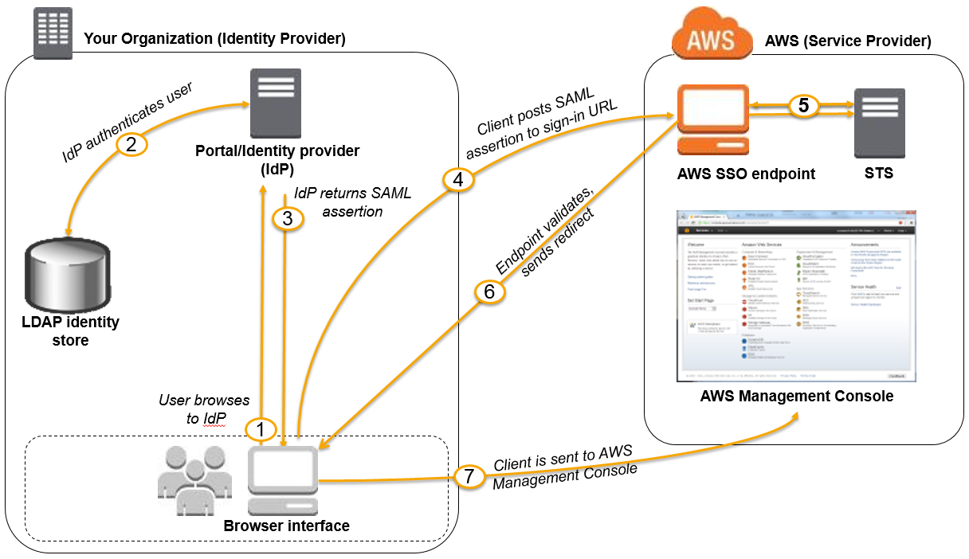
IAM - Enabling SAML 2.0 Federated Users to Access the AWS Management Console
https://docs.aws.amazon.com/IAM/latest/UserGuide/id_roles_providers_enable-console-saml.html

